Slide 1
PROJECT-2 [EDA]
Pokémon Dataset
10-June- 2025
By Team 4:
Saurav Raj Aryal 🏴‍
Shristi Kiju Shrestha
Manjil Shrestha
1

Slide 2

EDA
EDA( Exploratory Data Analysis) is key the process in data analysis where data is explored, analyzed and handled before giving it to train a model
EDA is the most important step in training AI model
It is used to obtain reliable information from a dataset
POKEMON
Pokémon is a popular Japanese anime released in 1997. This show consists of Pokémon which are comparable to our real world animals. There are different types of Pokémon with different characteristics and ability. This dataset provides us the data of such Pokémons.
LETS EXPLORE THIS DATASET
2

Slide 3
Dataset Structure: A Closer Look at the Data
Rows
800
Columns
13
Modules Used
Pandas, Matplotlib, Seaborn
Key Findings
1657 Unique values, 386 Null values and 0 duplicate values
3

Slide 4
Data Overview:
Extensive Collection
Core Combat Stats
Elemental Types
Over 800 unique Pokémon records captured
Key attributes: HP, Attack, Defense, Speed
Primary and secondary types for each Pokémon
4

Slide 5
All Features
Name ----- Name of the Pokemon------ object
Type 1 ----- Type 1 (Water, Fire, Electric)---object
Type 2 ----- Type 2----object
Total ------- Sum of all key attributes (HP, Attack etc)----int
HP ---------- Hit points/ Health----int
Attack ------ Attacking Power----int
Defense ----- Defensive Power-----int
Sp. Atk ------- Special Attack Power------int
Sp. Def ------- Special Defense Power-----int
Speed -------- Speed-----int
Generation --- (1,2,3,4,5,6)-----object
Legendary ---- Yes/No-----Boolean
Power --------- Sum of attack, defense and HP-----int
5

Slide 6
EDA Process Flow Diagram
Data profiling analysis and cleaning
Feature Engineering
Visualization
Handling Outliers
Findings
6

Slide 7
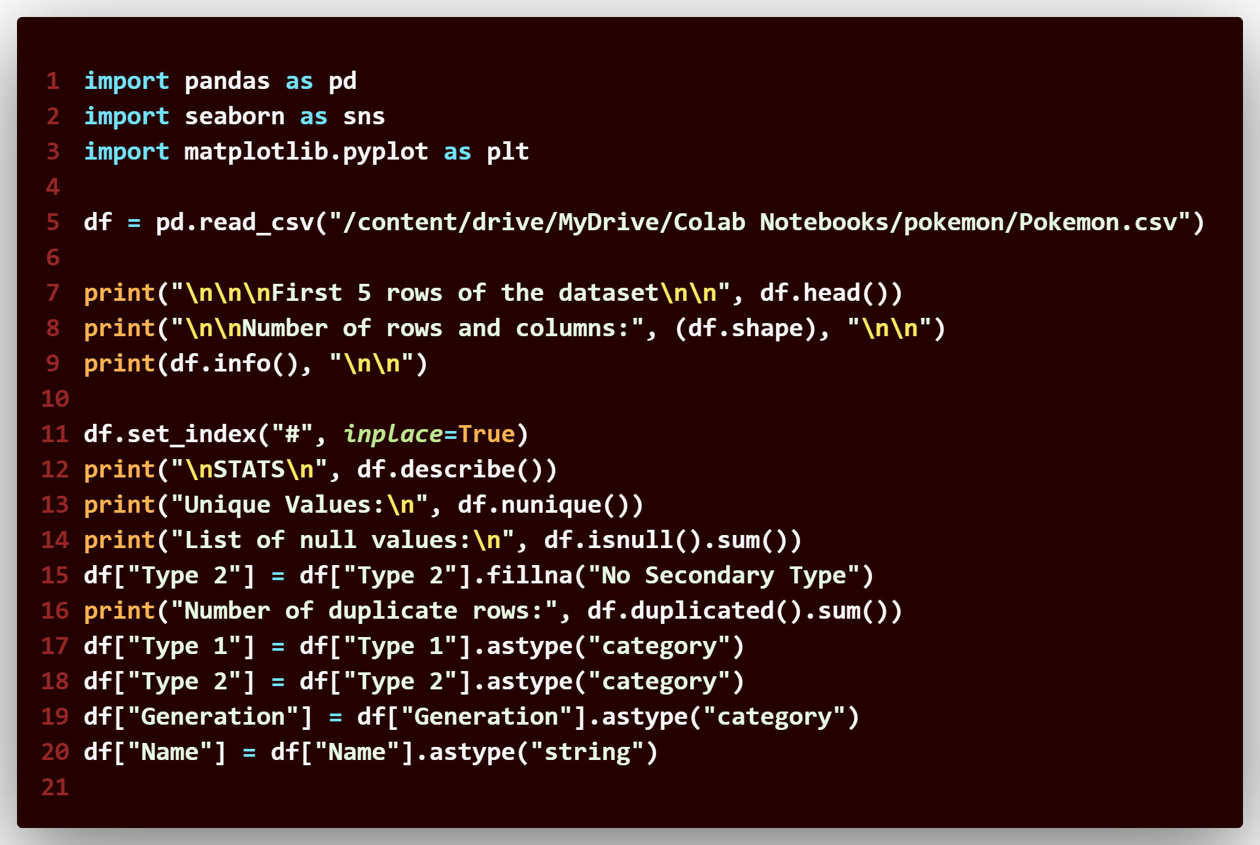
DATA PROFILING,CLEANING AND ANALYSIS
Functions used are:
read_csv()
head()
shape()
info()
describe()
nunique()
duplicated()
sum()
fillna()
isnull()
astype() for changing data types
7

Slide 8
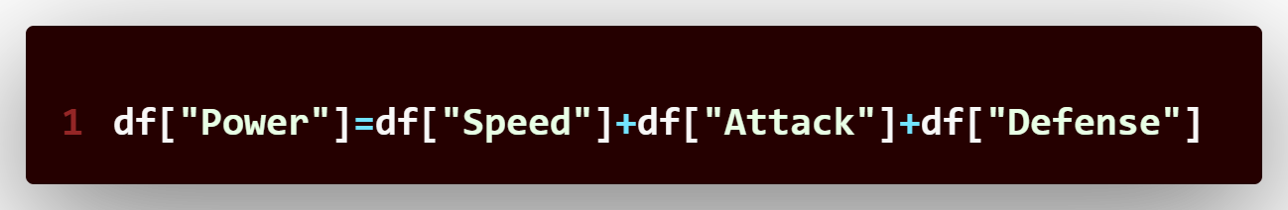




FEATURE ENGINEERING
Power Metric: Gauging Overall Strength
Speed
Attack
Defense
Power
Determines turn order
Physical damage output
Physical damage resistance
Combined strength metric
8

Slide 9
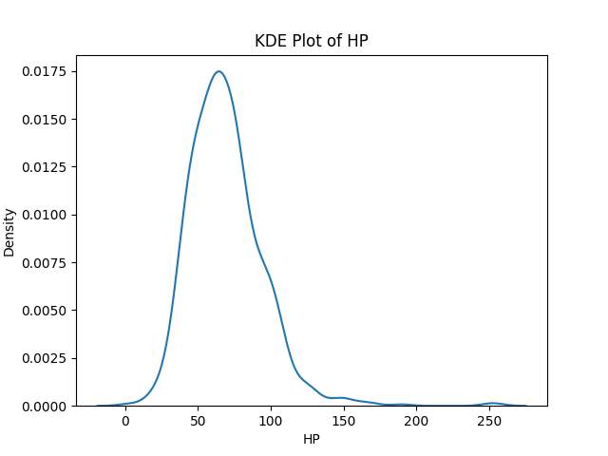
VISUALIZATION
Visualization is a technique through which we can visualize our data and its distribution. Visualization techniques used by us are:
Histogram
Line plot
Heat Map
KDE Plot
Bar Plot
Box Plot
9

Slide 10
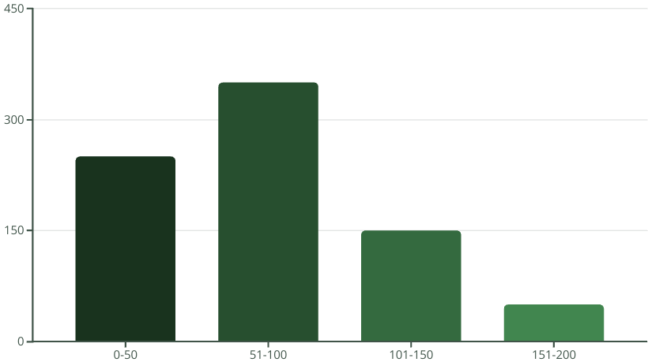
Special Attack Distribution
The distribution of Special Attack (Sp. Atk) values shows how powerful Pokémon can be in their special moves. We observe a varied range, with some Pokémon possessing exceptionally high Sp. Atk stats, indicating their potential as formidable special attackers.
Sp.Atk
10

Slide 11
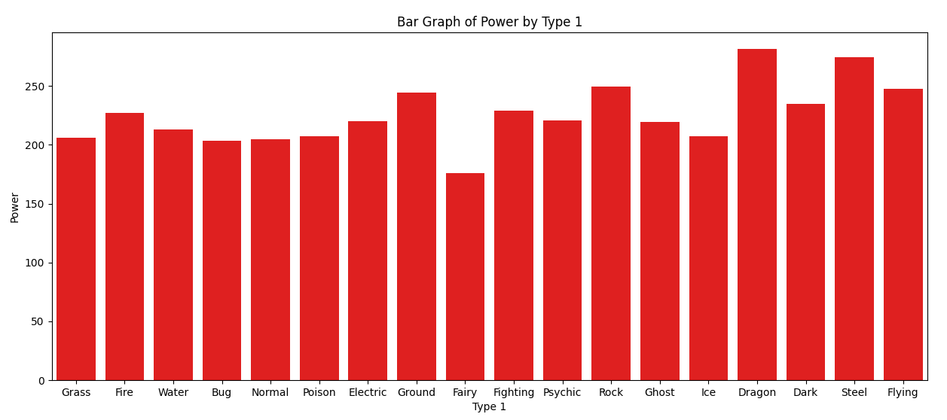
From this graph we can interpret that dragon type pokemon have the highest power whereas fairy type have the lowest power. Steel type are the most near to dragon type having 250+ power.
11

Slide 12
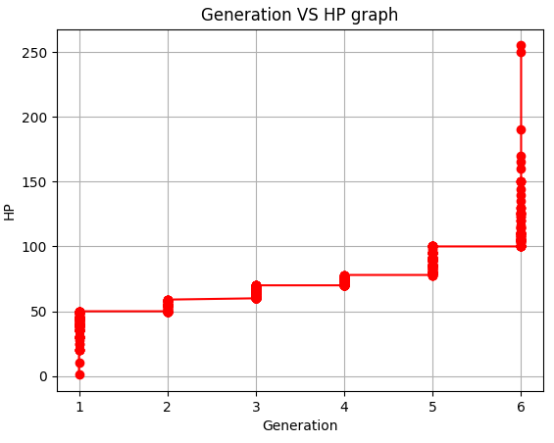
This line graph shows that as the generation increases the HP level of Pokémon increases as well. Even though it is not linear it is increasing. In generation 1 also there are different HP level but as generation increases there is slightly higher increase in HP.
12

Slide 13
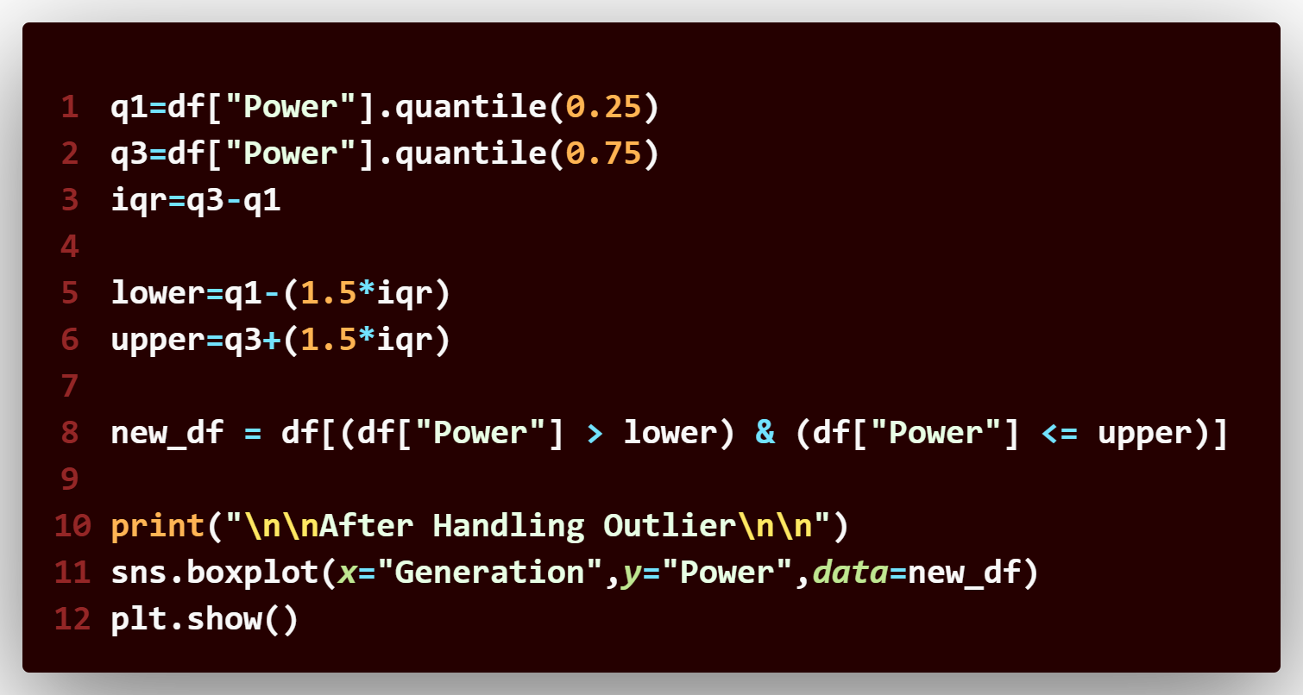
HANDLING OUTLIERS
We are handling the error using IQR( Inter Quartile Range) method and the value above lower and upper bound are removed to obtain a new dataset named new-df
13
The histogram of Hit Points (HP) reveals common and rare survivability ranges among Pokémon. Most Pokémon fall within the 51-100 HP range, indicating a balanced distribution, with fewer having very high or very low HP.

Slide 14
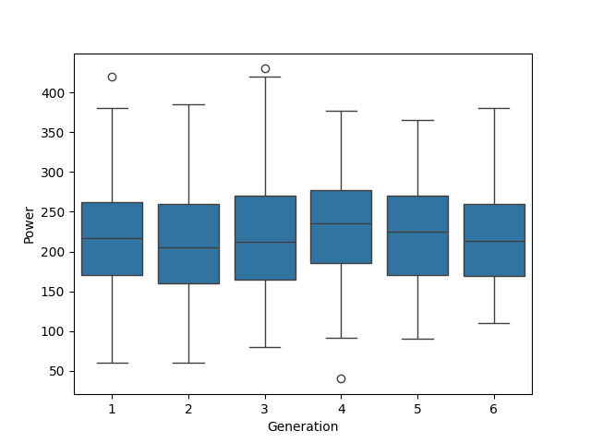
Before Handling the outliers
BOX PLOT
14

Slide 15
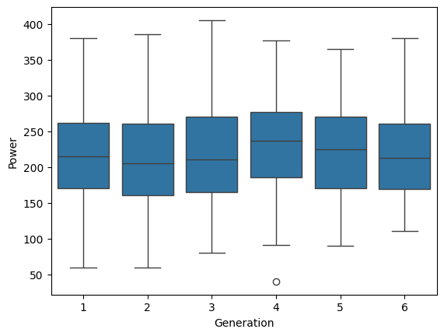
After Handling the Outliers
BOX PLOT
15

Slide 16
FINDINGS
Dataset had many null values which were filled.
Special Defense and Special Attack are highly correlated to each other.
Most of the Pokémon tends to have more than 1 type.
Very few of them are legendary.
This dataset had many issues issue such as null value, incorrect data type, outliers but all of them were solved using different techniques and as a result we obtained a clean and perfect dataset which can be used to train a model.
16

Slide 17
Data Analyzed
Data Cleaned
Ready to train model
New feature added
Data Visualized
CONCLUSION
Difficulties Faced:
Outlier was not removed even after trying many methods.
Solution: Consultation with both Piyush and Pujan sir
17

Slide 18
THANK YOU

